Slide 1
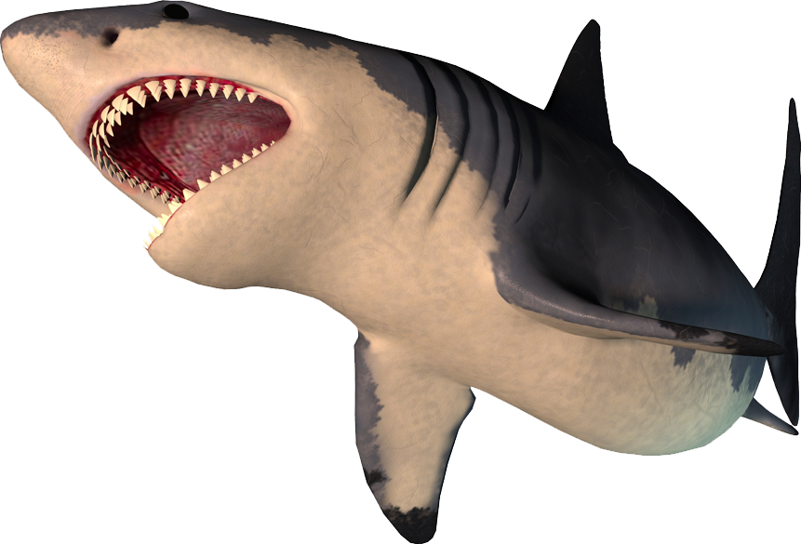
chomp!
chomp!
This presentation is brought to you by Grammar Bytes!, ©2015 by Robin L. Simmons.

Slide 2
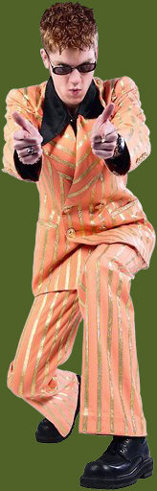
Pronoun Agreement
Everyone should know their pronouns?
Or his or her pronouns?

Slide 3
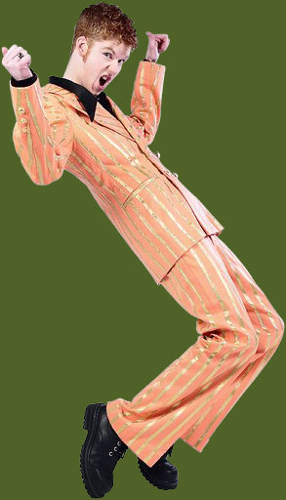
This presentation covers maintaining agreement between a pronoun and its antecedent.

Slide 4
A pronoun agreement item on an objective test might look like this . . .

Slide 5
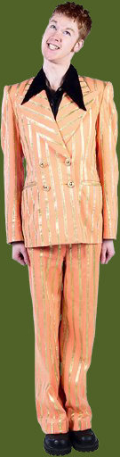
Sample Item
  Spendthrifts are quickly parted from their
  money. So a person who wants to start saving
  should not spend all of their time at the mall.
  his or her
  someone
  his
  No change is necessary.
  Spendthrifts are quickly parted from their
  A
  money. So a person who wants to start saving
  B
  should not spend all of their time at the mall.
  C
  his or her
  someone
  his
  No change is necessary.
  Spendthrifts are quickly parted from their
  A
  money. So a person who wants to start saving
  B
  should not spend all of his time at the mall.
  C
  his or her
  someone
  his
  No change is necessary.
The second their does not agree with a person, an error that choice C fixes.
Is the first their, a person, or the second their a problem?

Slide 6
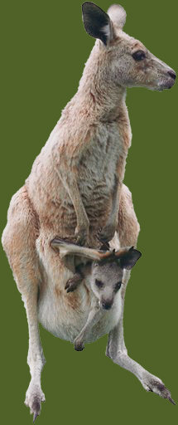
Agreement in a Nutshell
The kangaroo carries its joey in a pouch.
kangaroo = singular antecedent
its = singular pronoun
The kangaroos carry their joeys in pouches.
kangaroos = plural antecedent
their = plural pronoun

Slide 7
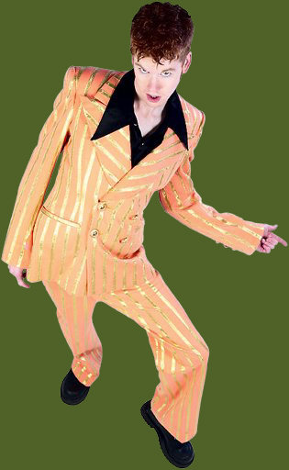
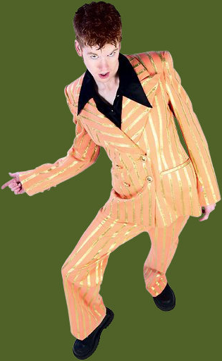
Know your pronouns.
Singular
he, she, it
him, her, it
his, her, hers, its
himself, herself, itself
Plural
they
them
their, theirs
themselves
Plural!
Singular!

Slide 8
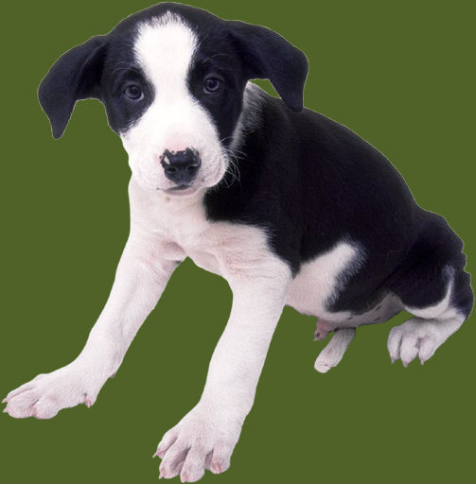
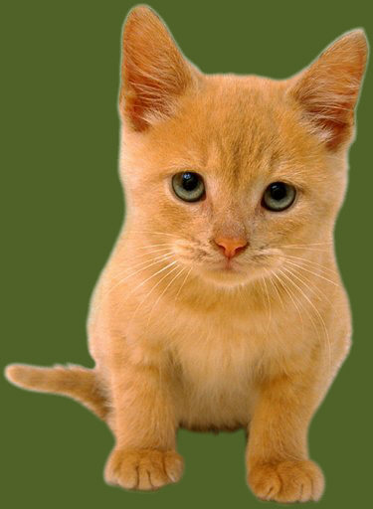
Two [or more] singular things joined by and make a plural antecedent.
  The new puppy and kitten have destroyed their owner’s sofa.

Slide 9
When each or every precedes two [or more] singular things joined by and, you have a singular antecedent.
  Each new puppy and kitten destroys its owner’s sofa.
  Every new puppy and kitten destroys its owner’s sofa.

Slide 10
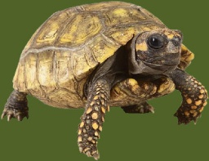

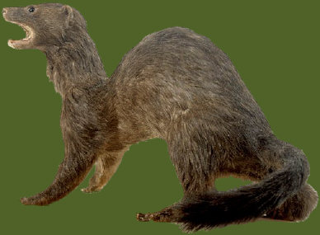
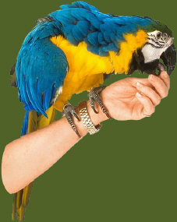

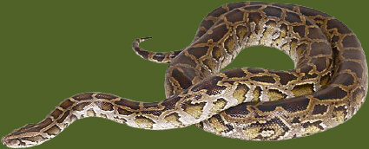
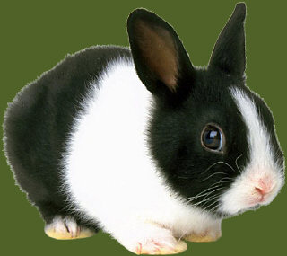
In this situation, no matter how many singular nouns you join with and, the antecedent is still singular.
Each new puppy, kitten, rabbit, tarantula, python, parrot, turtle, and ferret destroys its owner’s sofa.

Slide 11
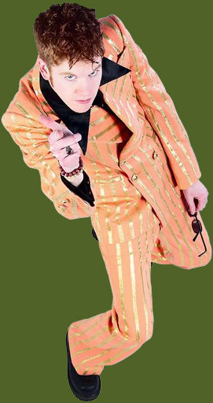
Use caution with these three conjunctions: either … or, neither … nor, and not only … but also.
Not only the Smiths but also Louise fixed their famous squid eyeball stew for the picnic.
Not only the Smiths but also Louise fixed her famous squid eyeball stew for the picnic.
Not only Louise but also the Smiths fixed their famous squid eyeball stew for the picnic.
You’ll have two antecedents — the Smiths and Louise — but only the closer one counts!
If you want to use their, you will need to flip the Smiths and Louise so that the Smiths are closer to the pronoun.

Slide 12
These indefinite pronouns are always singular [even when they seem plural].
Each, either, neither
Anyone, anybody, anything
Everyone, everybody, everything
No one, nobody, nothing
Someone, somebody, something

Slide 13
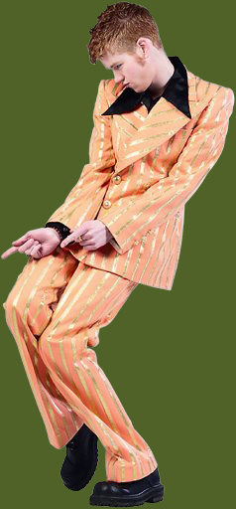
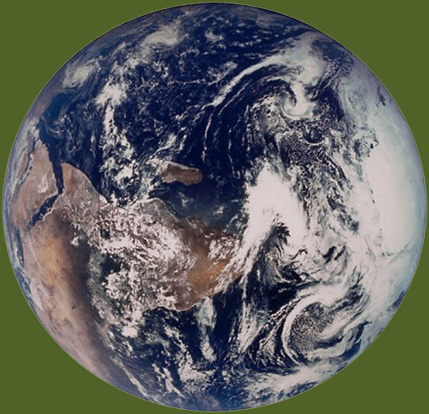
Everyone on Earth = more than one person—billions of people, in fact.
The word everyone, however, is still singular.

Slide 14

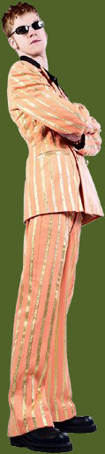
Beware interrupting phrases.
Neither of my two brothers show much
sense when they date women.
This sentence might sound right, but it is completely wrong!
Of my two brothers = prepositional phrase; neither = singular antecedent.

Slide 15
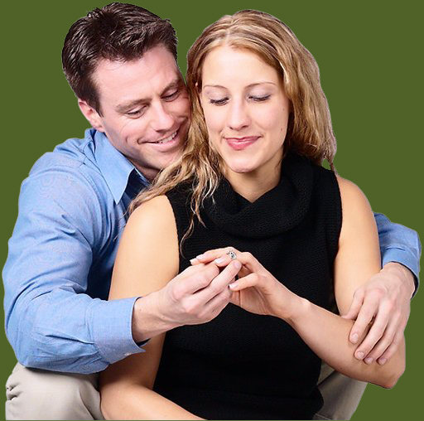
Wow, what a babe!
Wow, what a fat wallet!
Wow, what a loser!

Slide 16
Company, organization, department, and school names are singular.
One urban legend is that Tito’s Taco Palace makes their burritos with kangaroo meat.
One urban legend is that Tito’s Taco Palace makes its burritos with kangaroo meat.
We did not!
Did you know that?

Slide 17
Quick Test
Directions: In the items that follow, choose the option that corrects an error in the underlined portion(s). If no error exists, choose “No change is necessary.”
Show me what you know.

Slide 18
Item 1
  Not only my brothers but also Mom loves to drench their omelets in ketchup.
  his
  her
  his and her
  No change is necessary.
  Not only my brothers but also Mom loves to drench their omelets in ketchup.
  his
  her
  his and her
  No change is necessary.
  Not only my brothers but also Mom loves to drench their omelets in ketchup.
  his
  her
  his and her
  No change is necessary.

Slide 19
Item 2
  The students and their professor sweated in the
  hot classroom. Each one of them wondered why
  they had decided to commit to summer school.
  his or her
  Every
  she
  No change is necessary.
  The students and their professor sweated in the
  A
  hot classroom. Each one of them wondered why
  B
  they had decided to commit to summer school.
  C
  his or her
  Every
  she
  No change is necessary.
  The students and their professor sweated in the
  A
  hot classroom. Each one of them wondered why
  B
  she had decided to commit to summer school.
  C
  his or her
  Every
  she
  No change is necessary.

Slide 20
Item 3
  Robert and Sue Ellen concentrated on the dead worm on the dissection tray. They used tweezers to pick through innards looking for the heart.
  He
  She
  He or she
  No change is necessary.
  Robert and Sue Ellen concentrated on the dead worm on the dissection tray. They used tweezers to pick through innards looking for the heart.
  He
  She
  He or she
  No change is necessary.
  Robert and Sue Ellen concentrated on the dead worm on the dissection tray. They used tweezers to pick through innards looking for the heart.
  He
  She
  He or she
  No change is necessary.

Slide 21
Item 4
  The students have decided to eat at Tito’s Taco
  Palace, where they can order the special. Their
  discount burrito and soda will satisfy hunger, and its
  cheap prices will help wallets!
  he or she
  Its
  their
  No change is necessary.
  The students have decided to eat at Tito’s Taco
  Palace, where they can order the special. Their
  A B
  discount burrito and soda will satisfy hunger, and its
  C
  cheap prices will help wallets!
  he or she
  Its
  their
  No change is necessary.
  The students have decided to eat at Tito’s Taco
  Palace, where they can order the special. Its
  A B
  discount burrito and soda will satisfy hunger, and its
  C
  cheap prices will help wallets!
  he or she
  Its
  their
  No change is necessary.

Slide 22
Item 5
  Either of these thick books by respected authors will have the answer to your research question in their many pages.
  his
  his or her
  its
  No change is necessary.
  Either of these thick books by respected authors will have the answer to your research question in their many pages.
  his
  his or her
  its
  No change is necessary.
  Either of these thick books by respected authors will have the answer to your research question in their many pages.
  his
  his or her
  its
  No change is necessary.

Slide 23
Item 6
  If everyone stopped to smell the roses, they might
  get stung by bees and have their allergies kick in to
  overdrive!
  people
  he or she
  his or her
  No change is necessary.
  If everyone stopped to smell the roses, they might
  A B
  get stung by bees and have their allergies kick in to
  C
  overdrive!
  people
  he or she
  his or her
  No change is necessary.
  If people stopped to smell the roses, they might
  A B
  get stung by bees and have their allergies kick in to
  C
  overdrive!
  people
  he or she
  his or her
  No change is necessary.

Slide 24
Item 7
  Weaver Hill High has strange school colors. Their hot pink and bright yellow combination really stands out on the field.
  Its
  His
  His and her
  No change is necessary.
  Weaver Hill High has strange school colors. Their hot pink and bright yellow combination really stands out on the field.
  Its
  His
  His and her
  No change is necessary.
  Weaver Hill High has strange school colors. Their hot pink and bright yellow combination really stands out on the field.
  Its
  His
  His and her
  No change is necessary.

Slide 25
Item 8
  Sam is starving, and his buddies have just ordered
  their “upsized” meals. Despite Sam’s drooling,
  neither of them will part with their French fries.
  his
  him
  his
  No change is necessary.
  Sam is starving, and his buddies have just ordered
  their “upsized” meals. Despite Sam’s drooling,
  A
  neither of them will part with their French fries.
  B C
  his
  him
  his
  No change is necessary.
  Sam is starving, and his buddies have just ordered
  their “upsized” meals. Despite Sam’s drooling,
  A
  neither of them will part with his French fries.
  B C
  his
  him
  his
  No change is necessary.

Slide 26
Item 9
  Clyde refuses to return to the weight room because its staff always pokes fun of his skinny arms and legs.
  their
  his
  her
  No change is necessary.
  Clyde refuses to return to the weight room because its staff always pokes fun of his skinny arms and legs.
  their
  his
  her
  No change is necessary.
  Clyde refuses to return to the weight room because its staff always pokes fun of his skinny arms and legs.
  their
  his
  her
  No change is necessary.

Slide 27
Item 10
  Everyone should memorize a Shakespeare
  monologue for Mrs. Smith because the extra credit
  points will help them improve their averages at
  the end of the semester.
  The students
  him or her
  his or her
  No change is necessary.
  Everyone should memorize a Shakespeare
  A
  monologue for Mrs. Smith because the extra credit
  points will help them improve their averages at
  B C
  the end of the semester.
  The students
  him or her
  his or her
  No change is necessary.
  The students should memorize a Shakespeare
  A
  monologue for Mrs. Smith because the extra credit
  points will help them improve their averages at
  B C
  the end of the semester.
  The students
  him or her
  his or her
  No change is necessary.

Slide 28
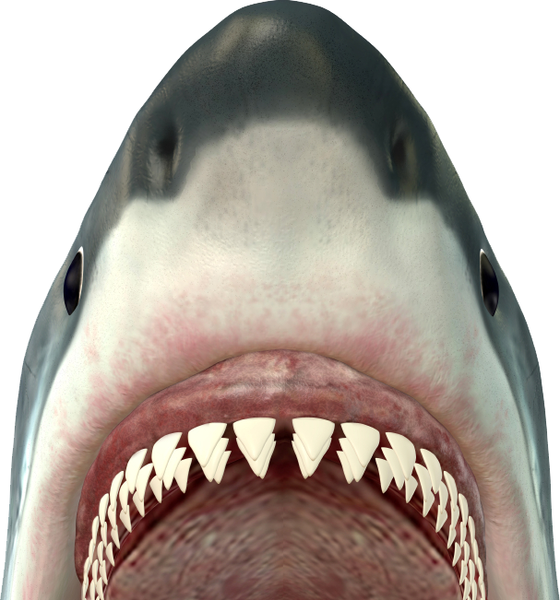
Grammar Bytes! provides additional handouts and exercises on pronoun agreement. Go to chompchomp.com!
chomp!
chomp!

Slide 29
The End.

